Slide 1

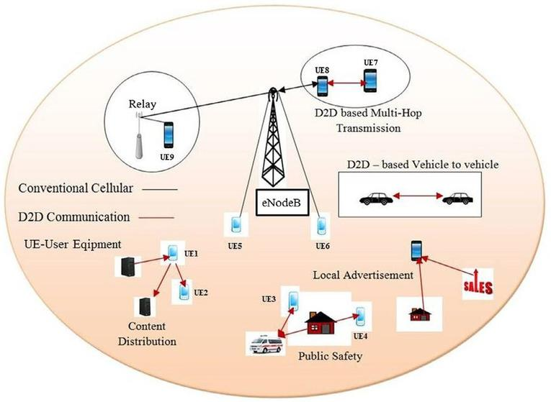
DATA NETWORKS PRESENTATION (GROUP 11)
Revenue Maximization of Maximally Satisfied Users in a D2D Network
Under The Guidance of DR. Jagadeesha R. B.

Slide 2
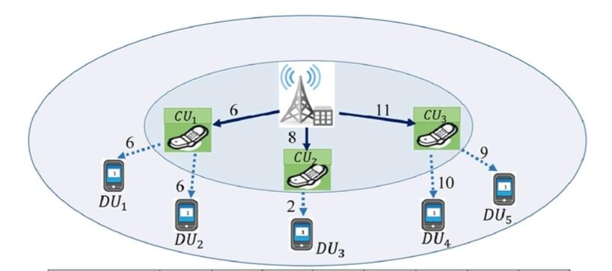
Problem Statement
In a multicast D2D network, each user may have different data request, based on their device capacity or resolution. Hence, we have to allocate different number of RBs accordingly.
It is an NP-Hard problem, so, it does not have an optimal solution. Hence, we have chosen a priority based method.
We have to maximize the number of users and the maximum profit obtained with first priority being given to the maximum number of users.

Slide 3


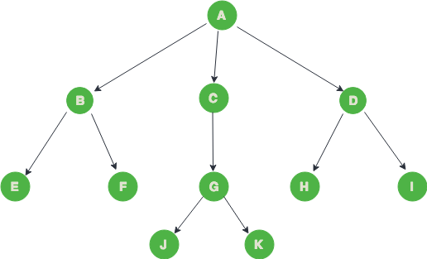
Our Approach
DATA STRUCTURE
ALGORITHM
We are using a generic tree data structure to store the data.
The proposed algorithm is a variation of Subset sum problem.

Slide 4

Algorithm
1
2
3
4
5
Taking Inputs
Arrangement
Finding subsets
Profit computation
Pinch-off
All the inputs for various users are taken. i.e. data requirement, CQI, profit offered. It is structured in the form of a generic tree.
Data is arranged in ascending order of resource blocks required.
All the subsets having maximum number of users and least number of resource blocks required is made.
Various subsets are compared based on maximum profit offered, The better one is chosen.
In case two subsets have same profit, the one with less requirement of resource blocks is chosen.

Slide 5

EXAMPLE
70
RB
Array of pointers to CU
pointer
pointer
pointer
CU User
Array of pointers to DU
CU User
Array of pointers to DU
CU User
Array of pointers to DU
15
1
20
3
5
4
12
3
24
5
RB
CQI
RB
CQI
RB
CQI
RB
CQI
RB
CQI
3800
15
5000
40
2500
20
4208
35
4500
70
Profit
Data Request
Profit
Data Request
Profit
Data Request
Profit
Data Request
Profit
Data Request

Slide 6
Total Input Data
30
2
9
6
10
3
RB
CQI
RB
CQI
RB
CQI
6500
60
5000
50
3000
30
Profit
Data Request
Profit
Data Request
Profit
CU3
Data Request
CU1
CU2
DU11
DU12
DU21
DU31
DU32
15
1
20
3
5
4
12
3
24
5
RB
CQI
RB
CQI
RB
CQI
RB
CQI
RB
CQI
3800
15
5000
40
2500
20
4200
35
4500
70
Profit
Data Request
Profit
Data Request
Profit
Data Request
Profit
Data Request
Profit
Data Request

Slide 7
Explanation
2. Arrangement
DU21 | CU2 | CU3 | DU31 | DU11 | DU12 | DU32 | CU1
5 | 9 | 10 | 12 | 15 | 20 | 24 | 30
3. Subset finding
DU21 | CU2 | CU3 | DU31 | CU1

Slide 8
Explanation
4. Profit Calculation
DU21 | CU2 | CU3 | DU31 | CU1
2500 | 5000 | 3000 | 4200 | 6500
Total | 21,200

Slide 9
Explanation
3. Pinch-Off
Subset | Total Profit
1-5 | 18,500
2-6 | 19,700
Obtained | 21,200

Slide 10
GRAPHS

Slide 11
100,000
75,000
Satisfied Profit
50,000
25,000
0
5
10
15
20
25
No. of Users

Slide 12
200,000
150,000
Satisfied Profit
100,000
50,000
0
100
200
300
400
500
No. Of RBs

Slide 13
Thank You
Team Members
AALEKH PRASAD (20BEC001)
PATEL DHARMESH (20BEC032)
RAJNISH KUMAR (20BEC035)
SAURABH MANI TRIPATHI (20BEC043)
VINAY KUMAR (20BEC056)

